Slide 1
Outer Join
Part II

Slide 2
Outer Join(Left, Right, Full)
Outer join gives results by taking:
Cartesian product
filter (join predicate)
get outer rows

Slide 3
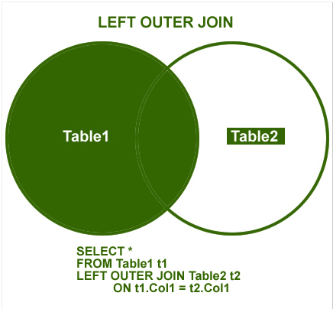
Left Outer join
In an left outer join, all rows from the first table mentioned in the SQL query is selected, regardless whether there is a matching row on the second table mentioned in the SQL query.

Slide 4
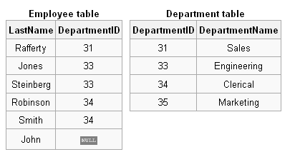
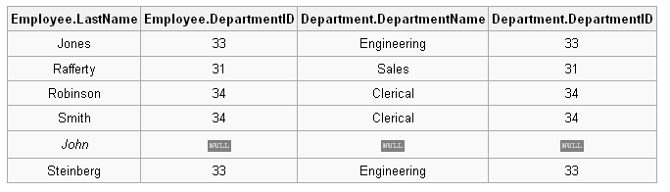
Example Query Left Outer Join
SELECT * FROM employee LEFT OUTER JOIN department ON employee.DepartmentID = department.DepartmentID;

Slide 5
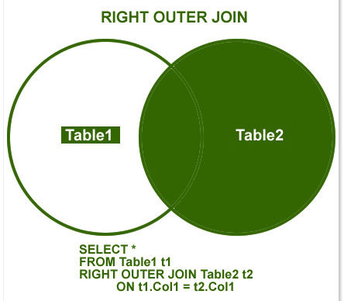
Right outer join
In an left outer join, all rows from the second table mentioned in the SQL query is selected, regardless whether there is a matching row on the first table mentioned in the SQL query.

Slide 6
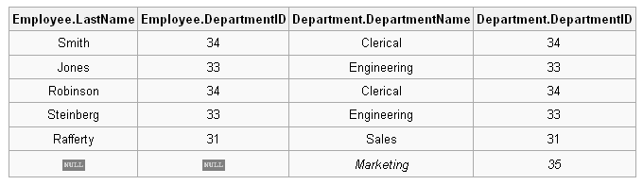
Right Outer Join Example Query
SELECT * FROM employee RIGHT OUTER JOIN department ON employee.DepartmentID = department.DepartmentID;

Slide 7
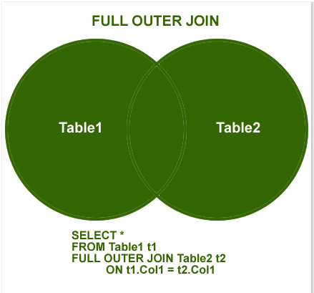
Full Outer Join
This join combines left outer join and right outer join. It returns row from either table when the conditions are met and returns null value when there is no match.

Slide 8
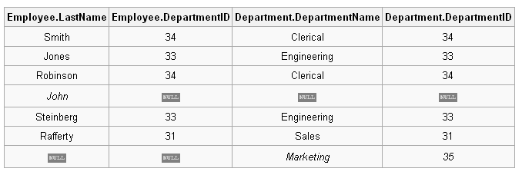
Full Outer Join Example Query
SELECT * FROM employee FULL OUTER JOIN department ON employee.DepartmentID = department.DepartmentID;

Slide 9
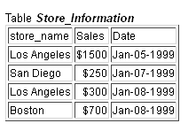
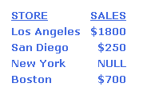
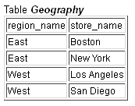
Class Activity
Find out the sales by stores. Output should have the results for all stores.
Your output should like:

Slide 10
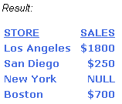
Left Outer Join Example Query
We want to find out sales by store, and we want to see the results for all stores regardless whether there is a sale in the Store_Information table.
SELECT A1.store_name STORE, SUM(A2.Sales) SALES FROM Geography A1 LEFT OUTER JOIN Store_Information A2 ON A1.store_name = A2.store_name GROUP BY A1.store_name

Slide 11
